Slide 1
Analyzing BehaviorSpace Results with Excel’s PivotTables
Steven Railsback
Lang Railsback & Assoc.
Arcata, CA, USA
Last updated: 29 October 2024
Copyright 2024 by Lang Railsback & Associates. You are welcome to use, distribute, and modify this document but not to restrict its use or distribution.
For further guidance on designing and analyzing agent-based models in NetLogo, please see our textbook: www.Railsback-grimm-abm-book.com. NetLogo is available at: ccl.northwestern.edu/netlogo.
If you find this document useful or have suggestions to improve it, please let me know by posting a note to the NetLogo Forum or by email: Steve@LangRailsback.com

Slide 2
Contents
The basics:
  What are PivotTables and why use them to analyze BehaviorSpace results (page 3)
  Creating a PivotTable from BehaviorSpace output (p. 4-6)
Example 1: A sensitivity analysis experiment (p. 7-13)
Example 2: A scenario contrast experiment (p. 14-16)
More tips and tricks (p. 17-23)
More complex analyses:
  Time-series results (p. 24)
  Frequency of events within simulations (p. 25)
  Frequency of events across simulations (p. 26-27)
  Time to an event (e.g., extinction) among simulations (p. 28-29)

Slide 3
The basics:
Why BehaviorSpace and PivotTables?
PivotTables are:
  Excel’s tool for rapid statistical analysis of spreadsheet data
  Menu-driven
  Saved with the Excel file.
PivotTables can be a very quick and easy way to analyze results of BehaviorSpace experiments. With minimal experience, you can extract basic results in a few seconds.
This guide uses the 2024 Office 365 version of Excel, in Windows.
(LibreOffice’s Calc spreadsheet and Google Sheets also have tools called Pivot Table, which are similar but not identical to Excel’s.)
Abbreviations:
  PTab = PivotTable
  BeSp = BehaviorSpace

Slide 4
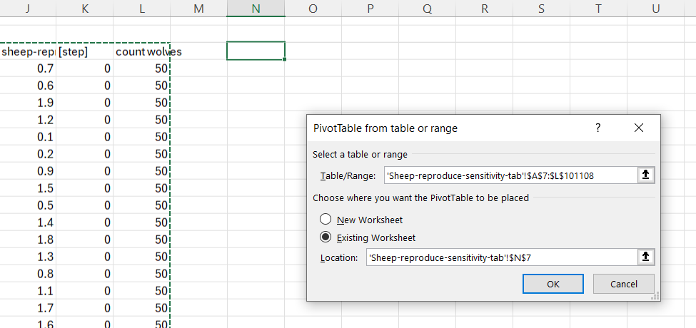
Basics: Creating a PTab from BeSp results
When running BeSp, select its “Table” output, not “Spreadsheet”.
Open the BeSp results table in Excel; save it in Excel format. (Tip: Use the .xlsb file format, which produces much smaller files than the standard .xlsx format.)
Create the PTab:
  Put the cursor where you want the table.
  From the Excel menu: Insert→PivotTable.
  In the pop-up dialog, select the data range you want to analyze, including the column headers (which become variable names). For BeSp tables, this is usually row 7 and below. (Tip: Put the cursor at cell A7, then use Cntl-Shift right-arrow, Cntl-Shift down-arrow to select all the data...unless there are blanks in the rightmost column).
  This creates an empty PTab but (idiotically) leaves you at the bottom of the data where you can’t see the PTab. Hit the up-arrow once and then the down-arrow to move to the PTab.
  Alternatively: Select the data, then Insert→PivotTable and then in the pop-up dialog, choose where you want the PTab. This is more convenient if you want the PTab on a separate worksheet.

Slide 5
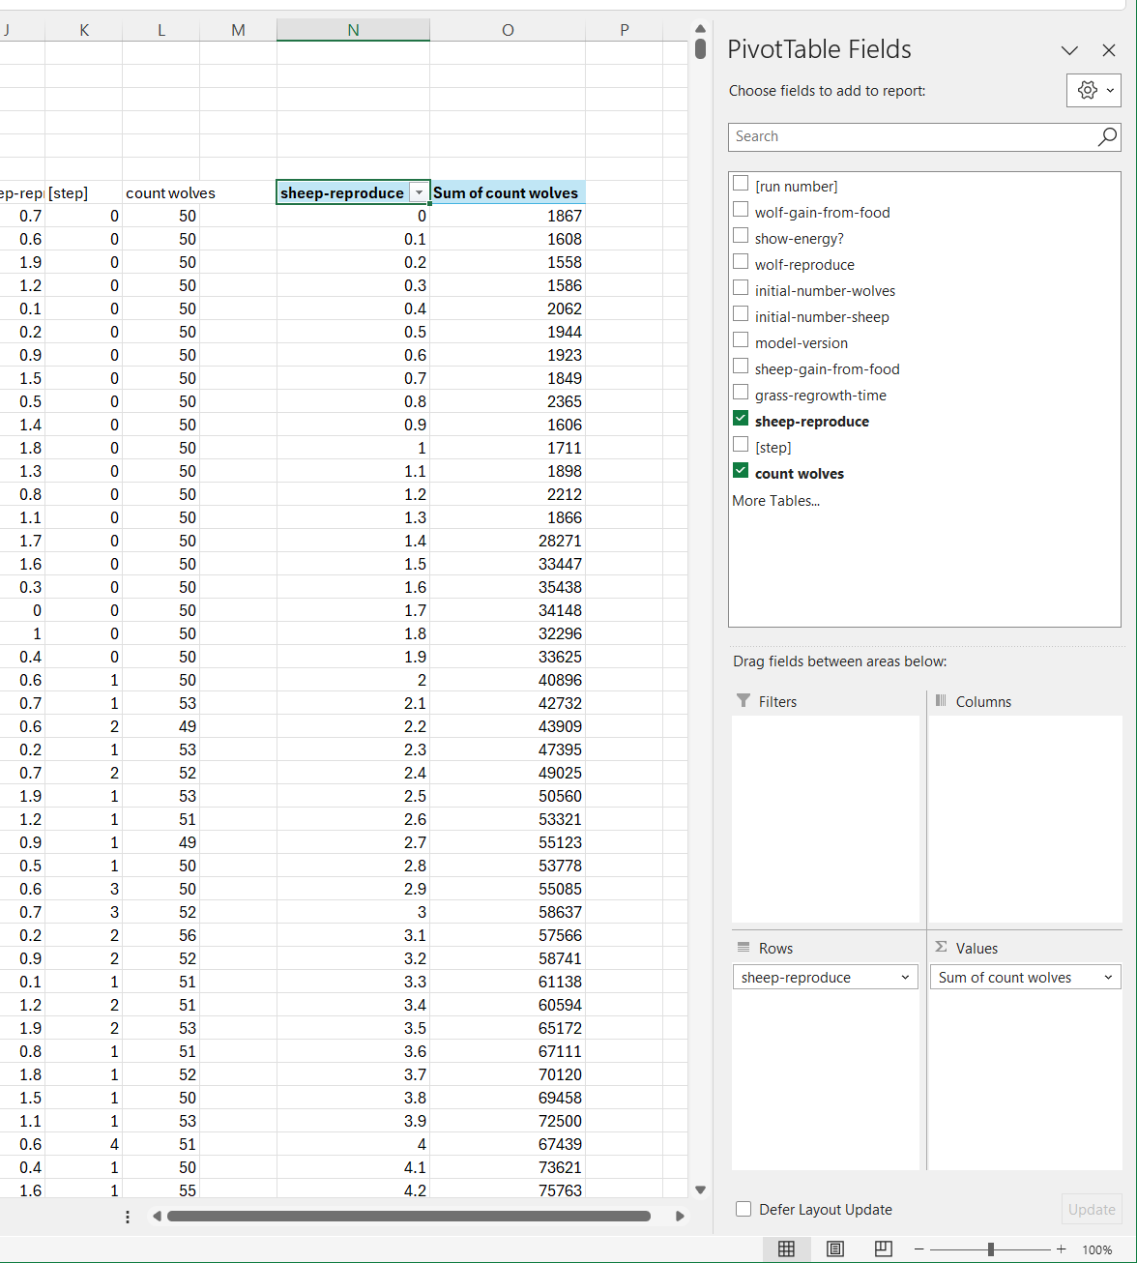
Setting up a PTab (1)
The PTab “Fields list” dialog appears whenever you have selected a cell inside a PTab.
The dialog lists all the variables (columns) in the data.
Simply drag the variable names into the Filters, Columns, Rows, and Values boxes to lay out the PTab. The PTab summarizes the Values, broken out by Row and Column variables.
In this simple example, the value of “count wolves” is summarized for each value of the “sheep-reproduce” parameter.

Slide 6
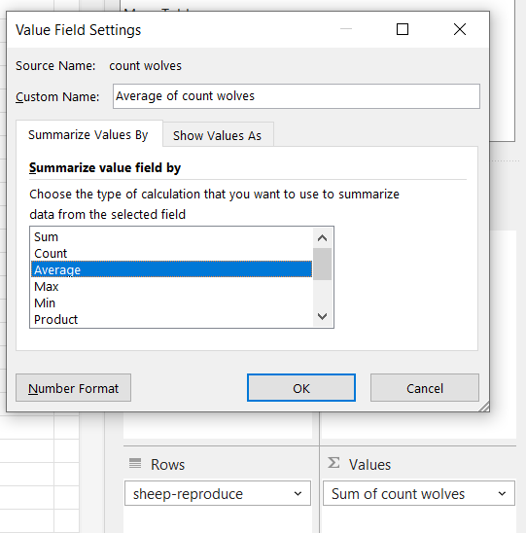
Setting up a PTab (2)
By default, PivotTable reports the sum of the variables in the Values field.
You can instead get the mean, max, min, count, etc. by clicking on Sum of ..., then selecting Value field settings (not shown here), and choosing a summary statistic.
You can put the same variable in the Values field more than once to get (for example) its min, mean, and max.

Slide 7
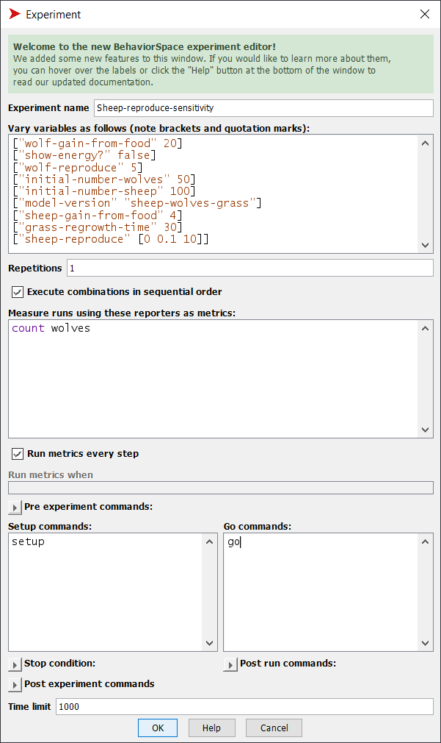
Example 1: A simple sensitivity experiment
A sensitivity experiment varies one or more model parameters and examines how selected model results respond.
Here, we use the NetLogo Models Library’s Wolf Sheep Predation model (under “Sample Models → Biology) and examine how one output—the number of wolves—responds to one parameter, sheep-reproduce.
This BeSp setup was used. It varies sheep-reproduce from 0.0 to 10 by 0.1, and runs the model for 1000 time steps. The value of count wolves is reported each tick.
We will analyze how the mean number of wolves over a simulation responded to the value of sheep-reproduce.

Slide 8
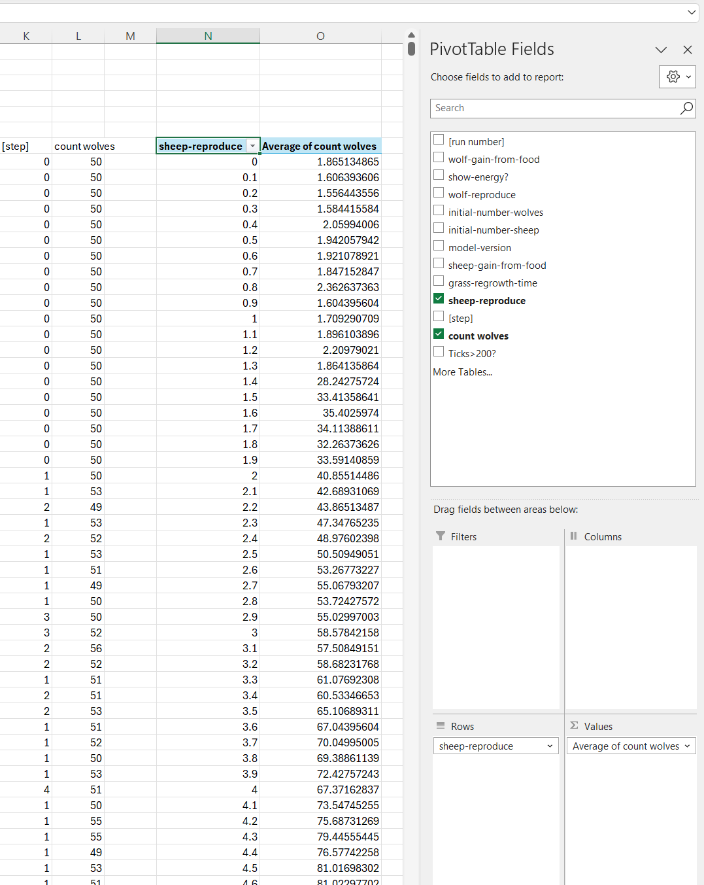
Example 1: A simple sensitivity experiment
Run the BeSp experiment, producing output in Table format.
Follow the steps described above to:
  Open the BeSp output in Excel,
  Create a PTab,
  Set up the PTab so it reports the mean of count wolves for each value of sheep-reproduce.

Slide 9
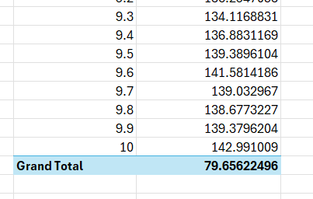
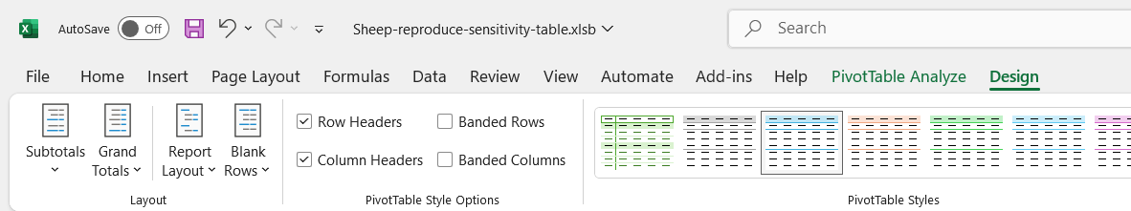
Tips and tricks (1): Grand Totals
By default, Excel adds “Grand totals” for PTab columns and (when applicable) rows.
These grand totals are usually a meaningless nuisance.
You can turn them off for a PTab by using the PivotTable Design menu (which is only visible when you’ve selected a cell within a PTab). Click on Grand Totals and set it to off for rows and columns.
In newer versions of Excel, you can turn grand totals off permanently using File→Options→Data→ Make changes to the default layout of PivotTables and setting Grand Totals to off.

Slide 10
Tips and tricks (2): Graphing
Usually, the first thing to do with PTab results is graph them.
If you try to simply select the PTab results and insert an Excel scatter plot (the only kind of graph that usually makes sense) you will find that Excel (idiotically) does not let you do so.
You can create a “Line” plot, but these are very dangerous—they look like XY plots but the X value on the chart is not always the X value of your data. Excel Line plots space all points evenly across the X axis, so if your data do not have evenly spaced X values the plot will be distorted. Excel even (very idiotically) lets you calculate regression lines for Line plots even though they can be meaningless and misleading.
Excel also has a PivotChart tool that works like PivotTables but creates charts instead of tables. But PivotChart (also idiotically) does not support XY plots.
If you want to make an Excel XY plot of your results, simply copy the PTab and paste the values elsewhere in your Excel file (using Paste As Values), and then create the plot.
If you have other software for graphing, use it.

Slide 11
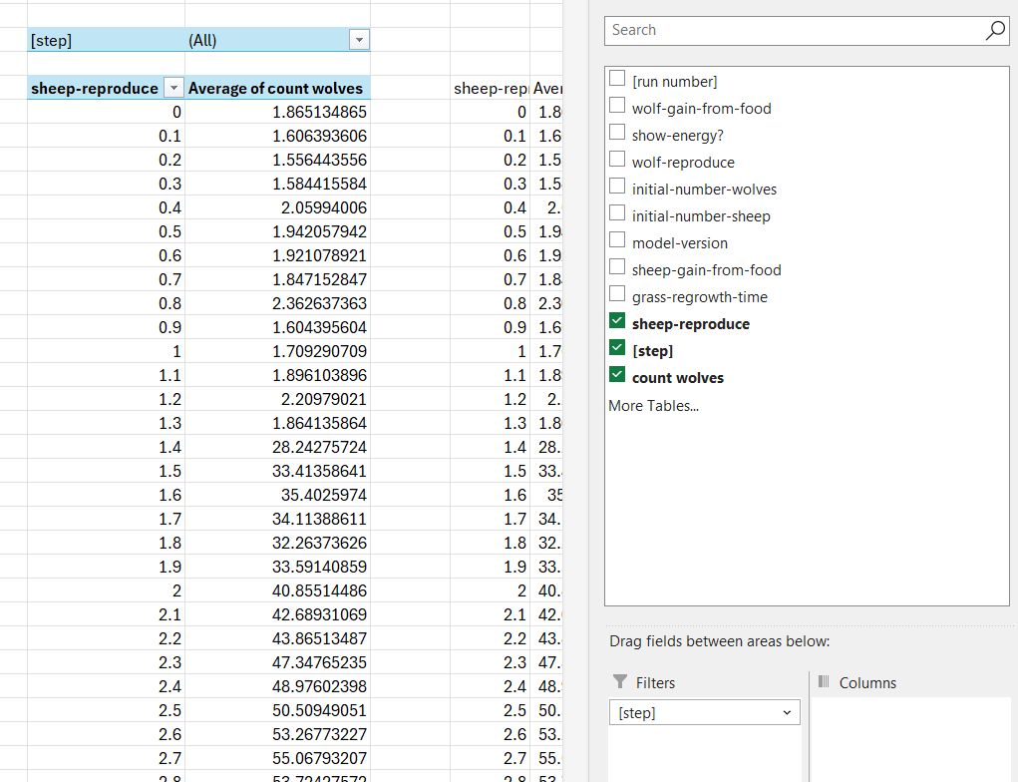
Tips and tricks (3a): Filtering results
Often, we want to analyze only some of the results. For our first sensitivity experiment, we might want to ignore the first 200 time steps because they are too influenced by the model’s initial conditions.
You can filter out steps <201 by dragging the [step] variable into the Filter box of the Field List.
This causes “[step]” to appear as a filter at the top of the table. Click on the chooser to select which steps to include in the analysis.
With 1001 steps in the simulation, this is tedious, so...

Slide 12
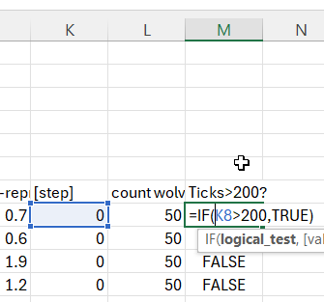
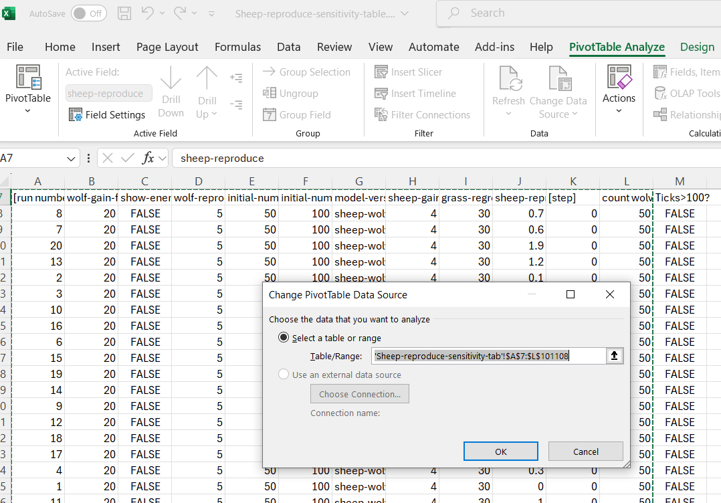
Tips and tricks (3b): Adding a variable to a PTab
We often want to add a variable that we create in Excel from the BeSp results to a PTab. One way to filter out the first 200 time steps is to create a TRUE-FALSE variable that reports whether a row of results was from after the 200th time step.
We insert a new column in the worksheet with a label “Ticks>200?”, and a formula that reports TRUE if the value of [step] is greater than 200.
Now we need to change the range of data in the PTab to include the new column. Do this using PivotTable Analyze→ Change Data Source.
Then...

Slide 13
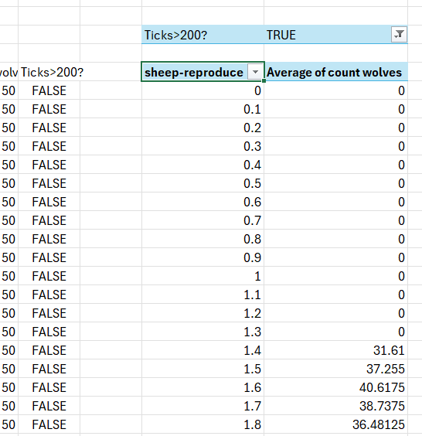
Tips and tricks (3b): Adding a filter variable
Now that the new Ticks>200? variable is in the PTab, drag it to the Filters box, and select only data rows where its value is TRUE.
Now we see why (from the graph above) wolf abundance was extremely low at values of sheep-reproduce < 1.4: the wolves went extinct before time step 200.

Slide 14
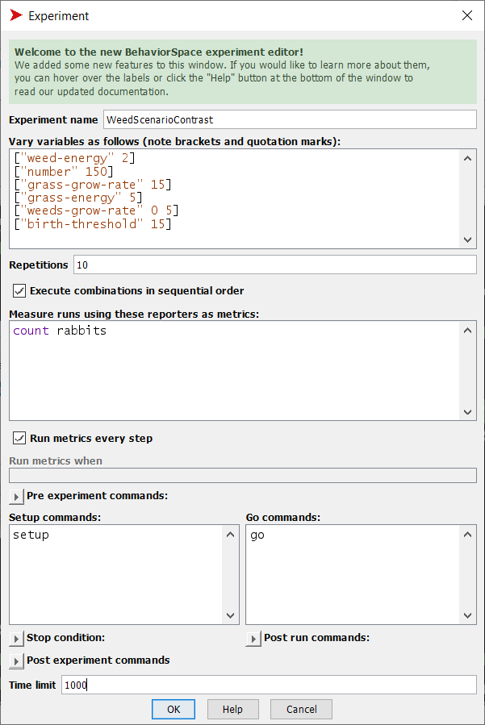
Example 2: A scenario contrast
Scenario contrasts are a second common kind of simulation experiment: we run 2 or more discrete scenarios and analyze how different their results were.
These experiments use replicates (“repetitions” in NetLogo) to distinguish effects of the scenarios from random variation.
For example: Lets look at the Rabbits Grass Weeds model (also in the Models Library’s Biology category) and how the number of rabbits differs between two scenarios: with and without weeds. We represent the scenarios as values of 0 and 5 for the parameter weeds-grow-rate.
The BeSp experiment runs each version of the model 10 times, for 1000 ticks.

Slide 15
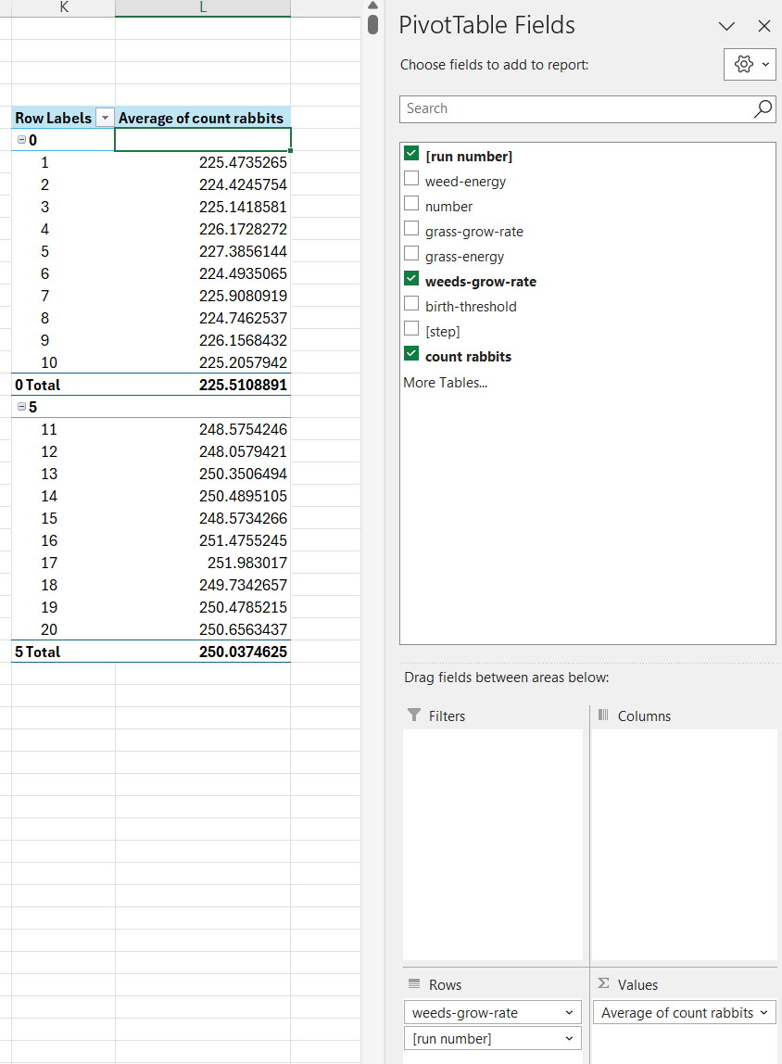
Example 2: A scenario contrast
Now we want to look at the mean number of rabbits in each replicate model run, to see if the difference between scenarios is meaningful compared to random variation.
We create a PTab from the BeSp table output, and tell it to report the mean number of rabbits, with separate rows for each of the two values of weed-grow-rate and for each model run.
However, Excel by default may (idiotically) produce a PTab that is hard to understand and analyze: it includes subtotals and doesn’t show the values of weed-grow-rate and run number for each row.

Slide 16
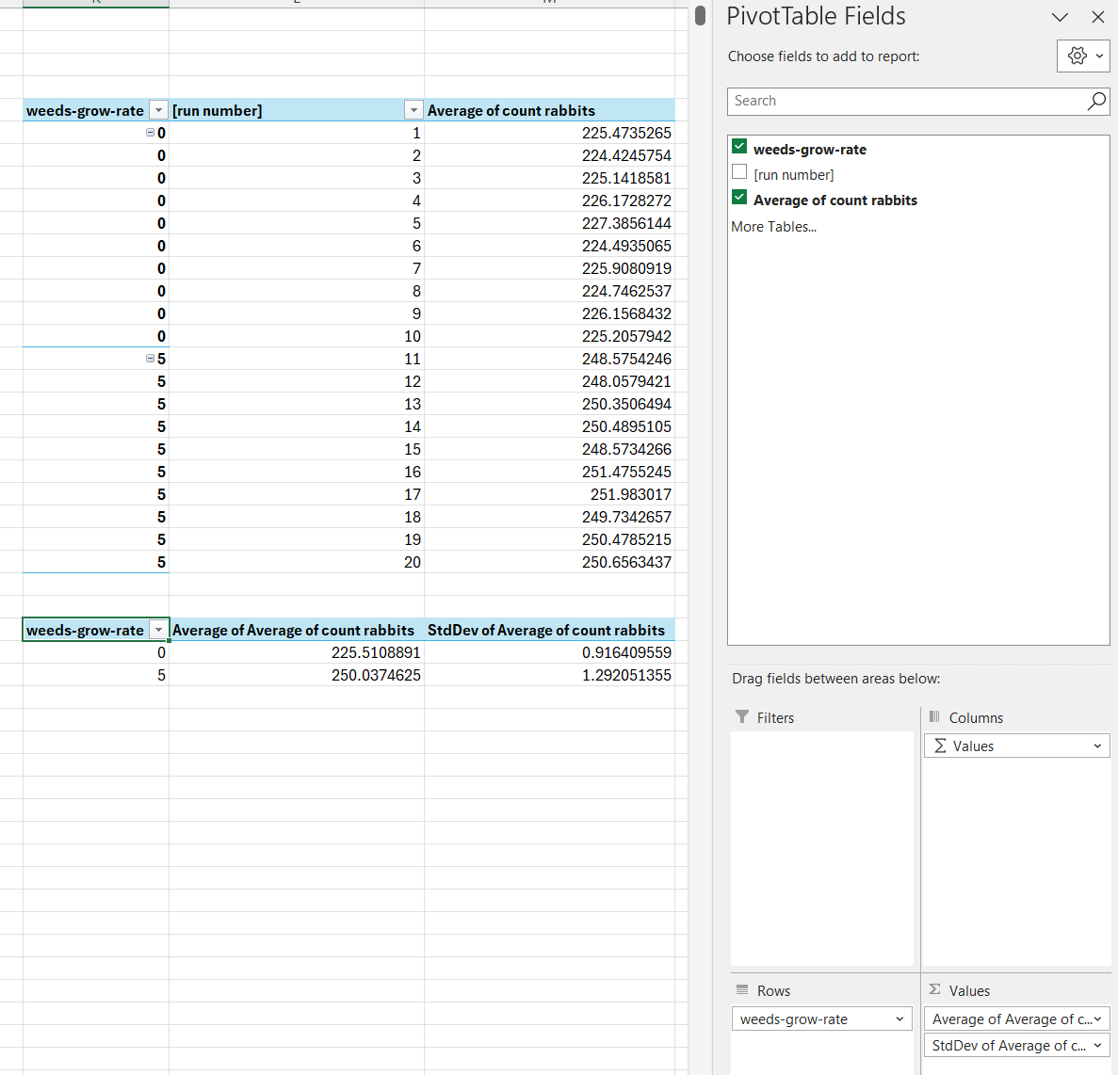
Example 2: A scenario contrast
You can make a usable PTab by selecting options in the PivotTable Design menu:
  Subtotals: Do Not Show Subtotals
  Report Layout: Show in Tabular Form
  Report Layout: Repeat All Item Labels.
You make these options the defaults in File→Options→Data→ Make changes to the default layout of PivotTables.
Now the table is easily analyzed. In fact, you can create a second PTab that uses the first PTab as data, to calculate the mean and standard deviation in rabbit abundance across runs, for the two scenarios. (The difference between scenarios is large compared to random variation within scenarios.)
Or you can paste the first PTab’s values into statistics software to do analyses such as ANOVA.

Slide 17
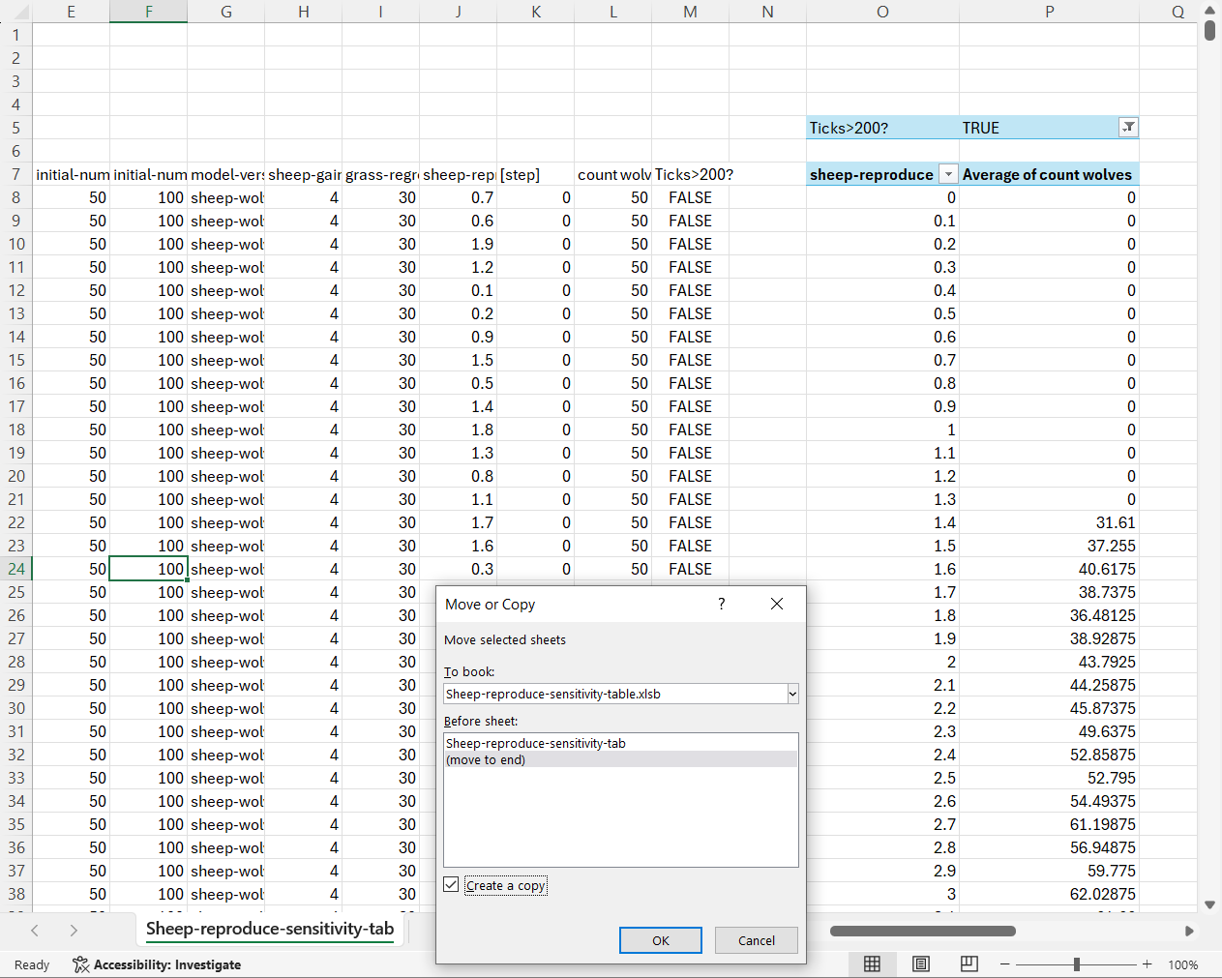
More tips and tricks
(1) Copying PivotTables
If you run a BeSp experiment several times, or run several similar experiments, you will want to copy and modify an existing PTab instead of creating a new one for each experiment. This is easy but there is one important step that is not obvious!
One easy way to copy and reuse a PTab is to copy the Excel worksheet that contains the BeSp results and a PTab that analyzes those results.
  Right-click on the worksheet tab
  Select Move or Copy and check Create a copy.

Slide 18
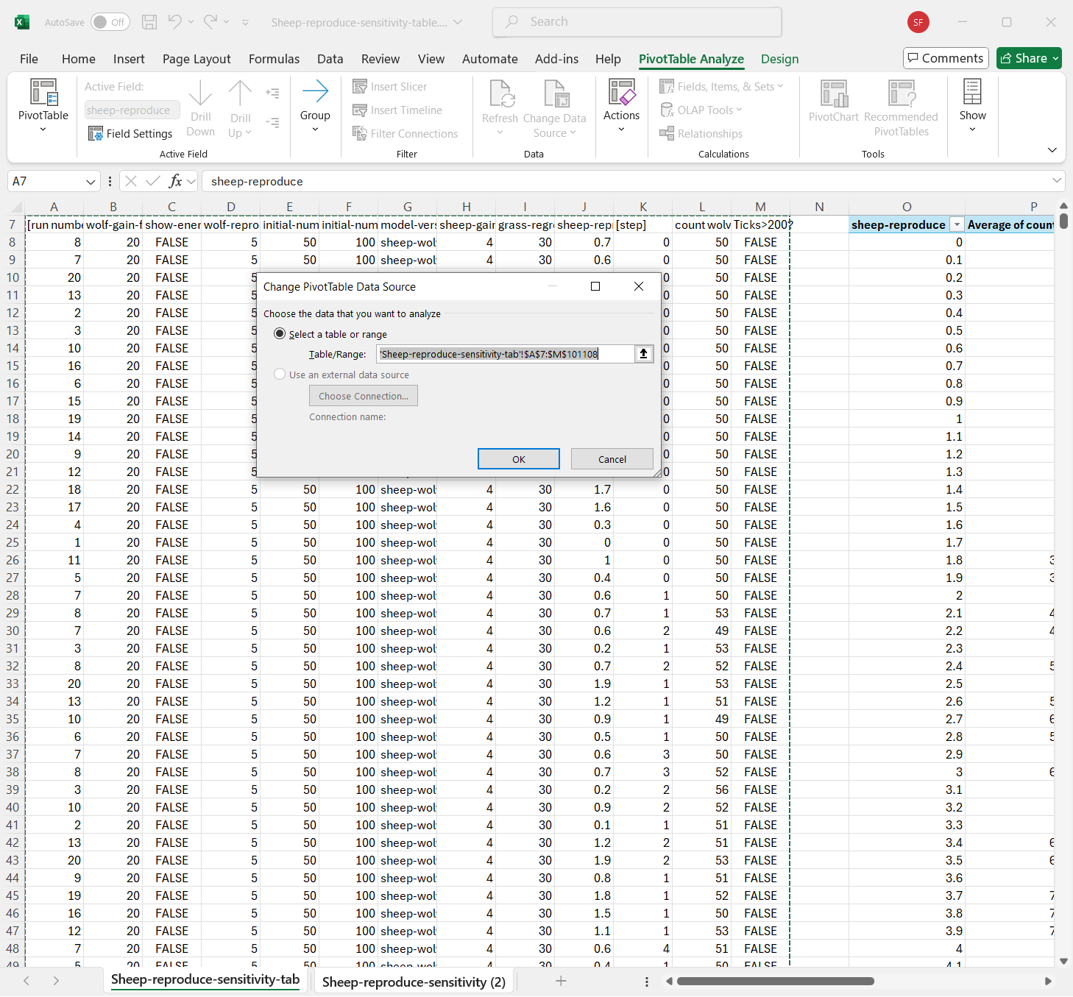
More tips and tricks
(1) Copying PivotTables
Now go to the new worksheet and:
  Change its name to reflect the new experiment
  Delete the old BeSp results
  Copy in the new BeSp results (e.g., after opening a new results table as a separate Excel file)
  The important part: select a cell in the PTab and use PivotTable Analyze→Change Data Source to select the new BeSp results.
  When you create a copy of a PTab, the new copy still refers to the old data range, even when the old data are in a different worksheet!! So you must use this step to select the correct data to analyze.

Slide 19
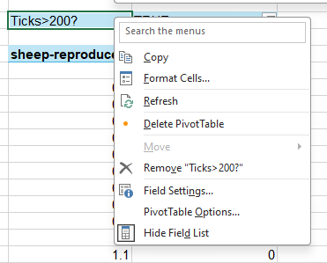
More tips and tricks
(2) Refresh
If you modify the data in a PTab (e.g., by replacing it with results from a new experiment), the PTab’s results are not updated automatically.
You must tell the PTab to refresh: Just right-click anywhere in the PTab and select Refresh.

Slide 20
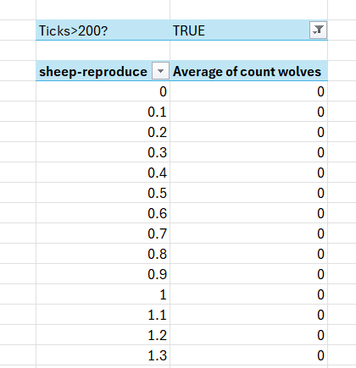
More tips and tricks
(2) Sorting rows or columns
Sometimes Excel does not sort a PTab’s rows or columns in the order you want. Be aware that rows that are labeled by a number (e.g., the value of a parameter varied in a BeSp experiment) may not always appear in ascending order.
You can sort the rows or columns by clicking on the chooser-like icon in the row/column label cell.

Slide 21
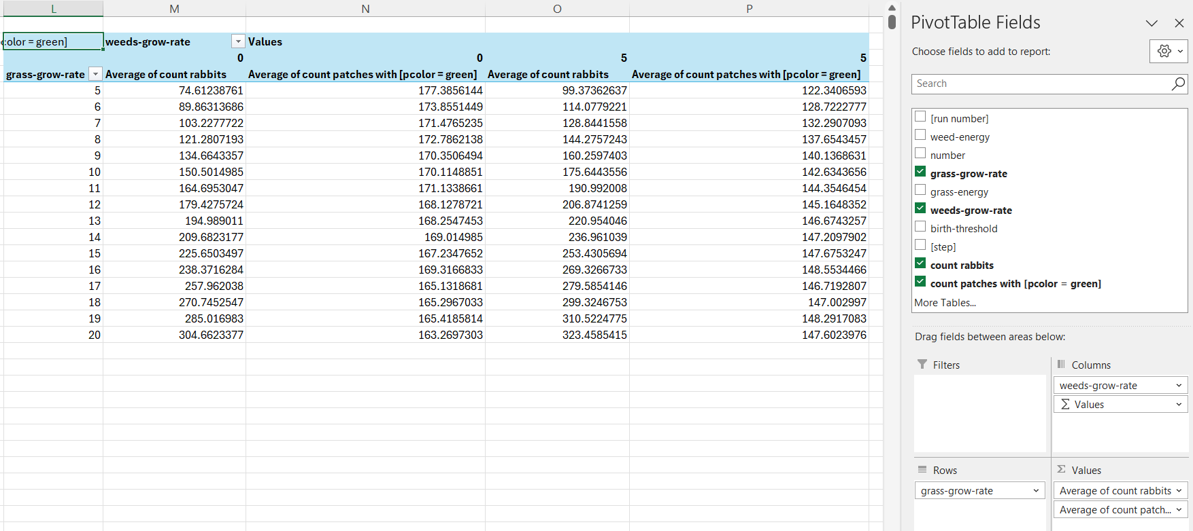
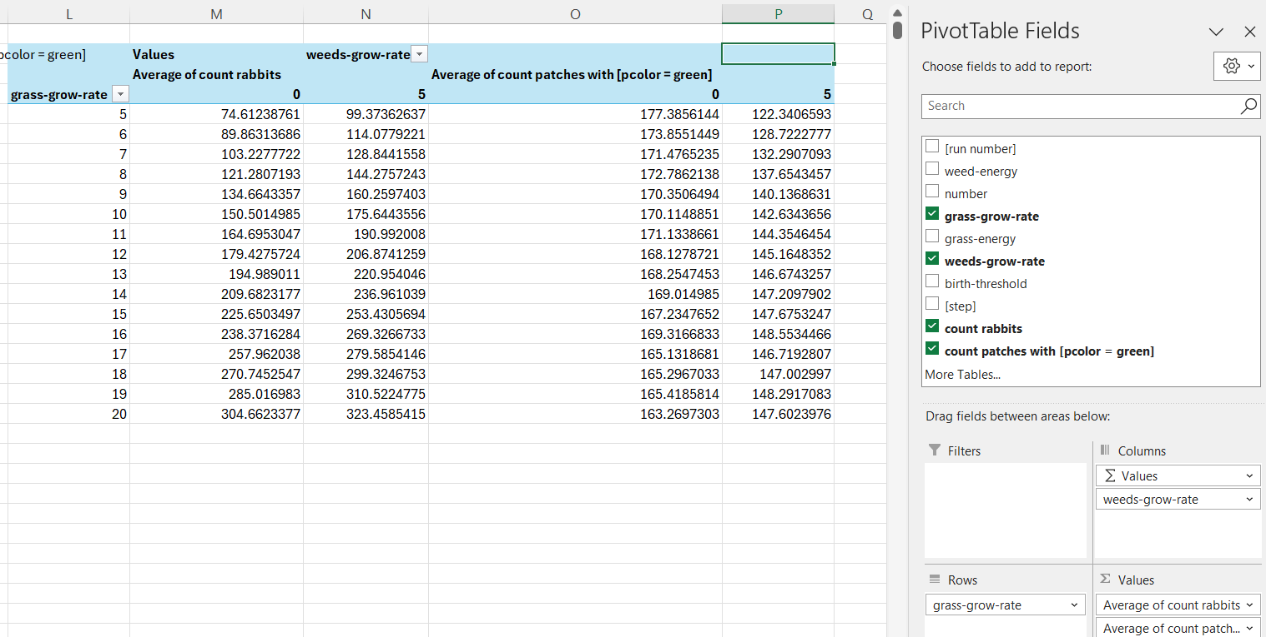
More tips and tricks
(3) More complex tables
Consider a more complex BeSp experiment, using 16 values of grass-grow-rate for each of two values of weeds-grow-rate, and producing two outputs: the numbers of rabbits and green patches (indicating they have grass).
We can get summary results of both outputs, broken out by both variables, in one table.
By default, a PTab groups the two outputs for each value of the variable(s) in the Columns box.
To instead groups the kinds of output together (count rabbits for all values of weeds-growth-rate, then count green patches for all values of ), just drag “Σ Values” from the bottom to the top of the Columns box.

Slide 22
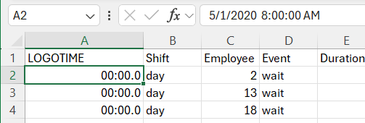
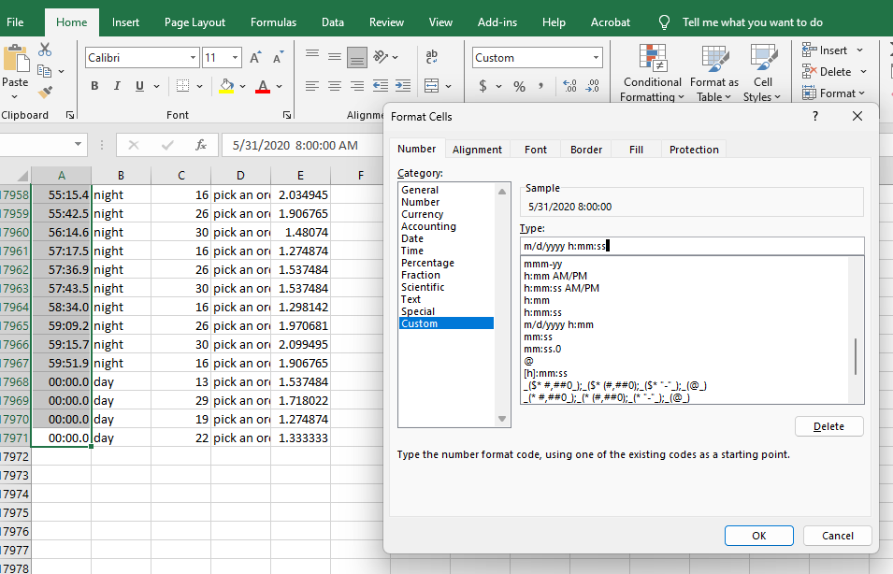
More tips and tricks
(3) Date and time variables
NetLogo’s time extension can create output in a variety of date and time formats. Excel automatically converts such values to its own date/time format (the number of days since 1/1/1900, with time as a fraction of a day).
When Excel converts date/time variables, it often displays them in an unuseful format.
For an example, open this NetLogo library model: Code Examples→Extensions Examples→time → Distribution Center Discrete Event Simulator.
  Save the model to a local folder, run it, and click the Save worker performance to file button.
  If you open the resulting file (WorkerPerformanceLog.csv) in a text editor, the date/time values look like:
  2020-05-01 08:00:00.000
  When you open the file in Excel, it instead looks like this 00:00.0 even though it is clear from Excel’s Task Pane that the value is correct.
Fix Excel’s date/time format by selecting the date/time values and manually setting their display format. That often requires one of Excel’s “Custom” formats. You can even edit the format.

Slide 23
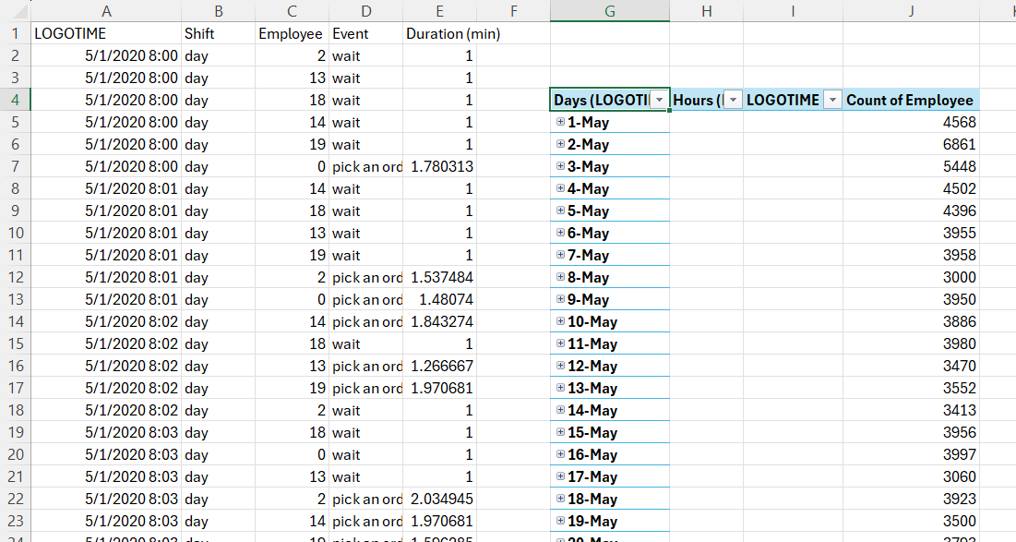
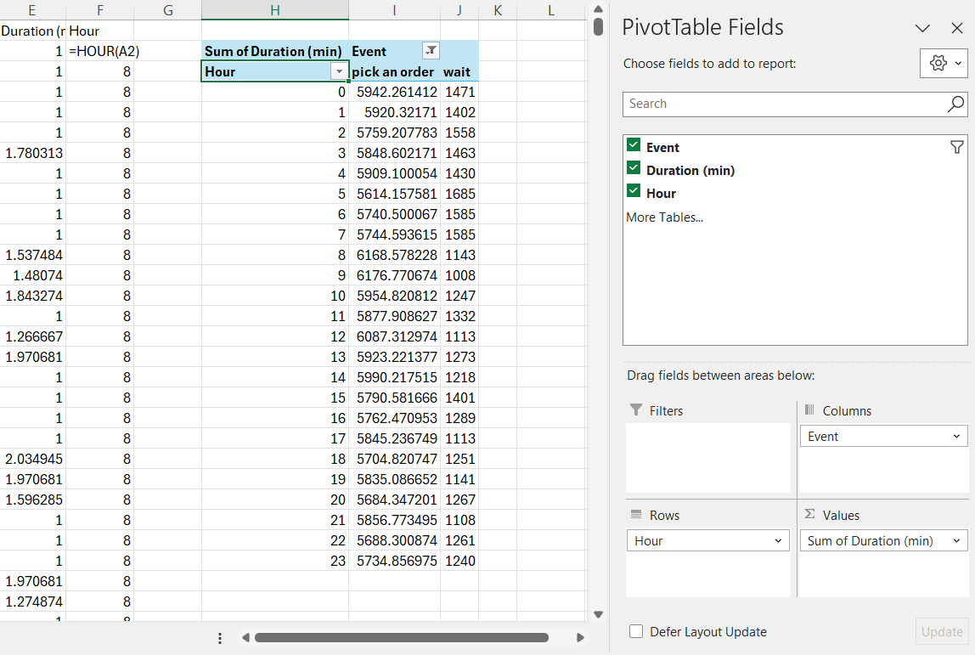
More tips and tricks
(4) Automatic grouping of date/time values
If you make a PTab of data that includes a date/time variable, new versions of Excel automatically break the table into subtotals, here by day.
This idiotic and extremely annoying “feature” can only be turned off via the Excel menu: select File →Options →Data and check the box Disable automatic grouping of Date/Time columns in PivotTables.
If you want results broken out by time periods, create a new variable that rounds the BeSp date/time value to the unit you want, and add that variable to the PTab.
  Use Excel’s TRUNC function to change date/times to integer days.
  Use Excel’s HOUR, MONTH, YEAR, WEEKNUM, etc. functions to round off to other time units.
In this example from the worker performance file, Col. F calculates the hour in which each event happened, and the PTab shows the total time spent on each event type, by hour, over a month.

Slide 24
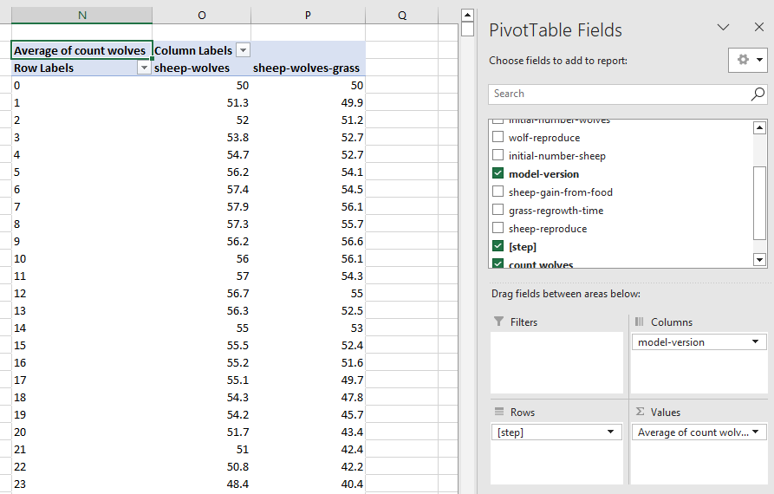
More complex analyses
(1) Time-series results
To see results over time, simply put [step] in the PTab as the Rows variable.

Slide 25
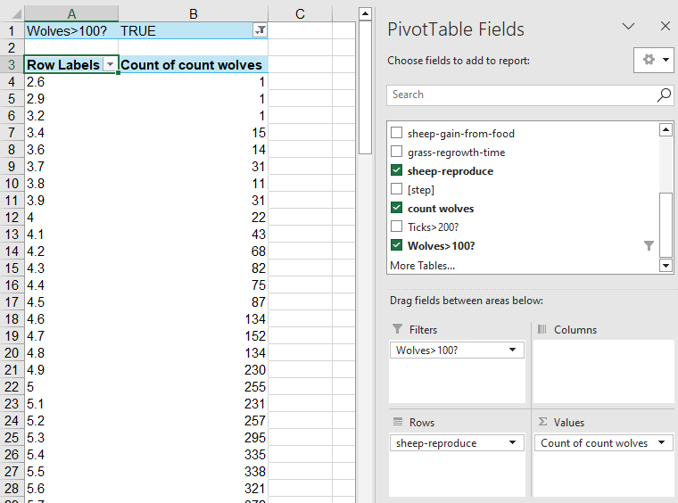
More complex analyses
(2) Frequency of events within a simulation
To see how many times some event occurred within each simulation:
  In either BeSp or Excel, create a TRUE/FALSE variable that is TRUE when the event occurs (here: when the number of wolves is > 100).
  Make that variable a filter in the PTab and select TRUE values.
  Put any other variable in the Values field and set its value type to Count.
The PTab now reports the number of outputs on which the event occurred.

Slide 26
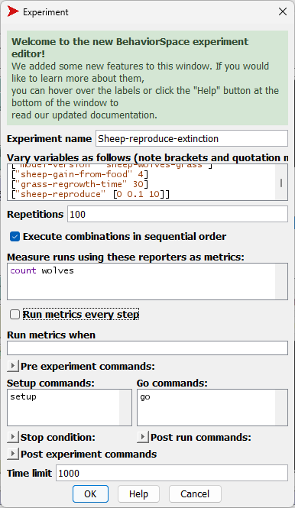
More complex analyses
(3) Frequency of events across simulations
We sometimes want to see how often simulations produce a specific result, e.g., how frequently a population goes to zero within X time steps.
Here we look at the Wolf Sheep Predation model and how the frequency of wolf extinction varies with the parameter sheep-reproduce. We define “frequency of extinction” as the percentage of 100 model runs in which no wolves are alive after 1000 time steps.
Therefore, we set up BeSp to execute 100 repetitions of each parameter value, and output only the final number of wolves. (The 10100 model runs take only a few minutes to execute.)
Then…

Slide 27
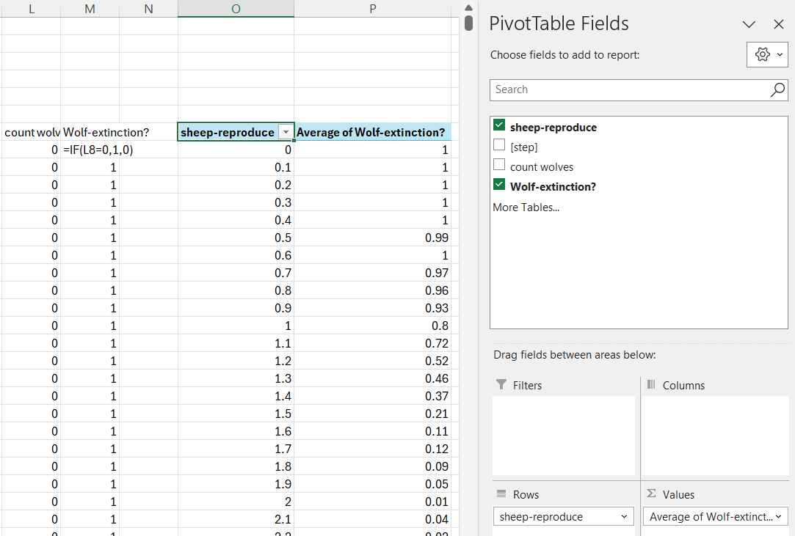
More complex analyses
(3) Frequency of events across simulations
To evaluate “frequency of extinction” as the percentage of 100 model runs in which no wolves are alive after 1000 time steps:
  Create a new variable (Wolf-extinction?, Column M) equal to 1 if wolves went extinct and 0 if they did not.
  Create a PTab that calculates, for each value of sheep-reproduce, the mean value of Wolf-extinction?.
The result is a sharp decrease in extinction rate as sheep-reproduce increases from 0.5 to 2.0.

Slide 28
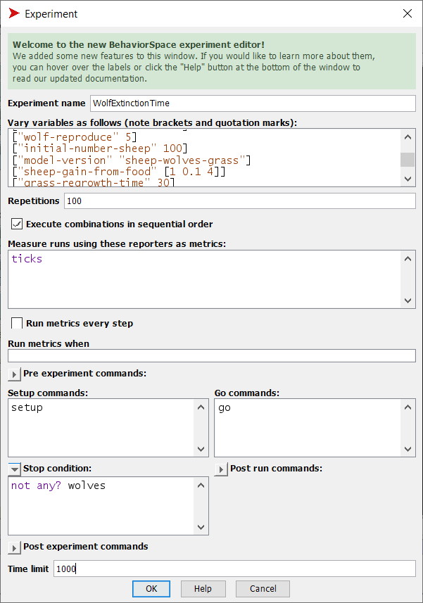
More complex analyses
(4) Mean time to an event, across simulations
This analysis is like the previous except now we examine the time until an event (again, extinction) happens.
We set up BeSp to:
  Execute 100 repetitions for each parameter value, this time for sheep-gain-from-food
  Stop when there are no more wolves, or at 1000 ticks
  Report the tick at which the run stops.
Then…

Slide 29
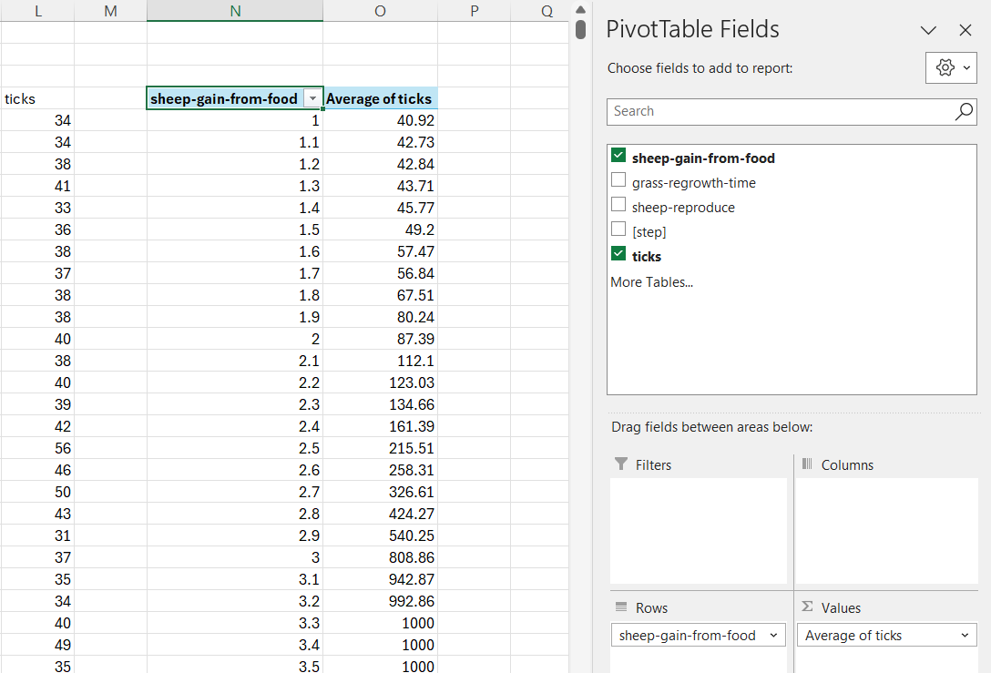
More complex analyses
(4) Mean time to an event, across simulations
If we define “mean time to extinction” as the mean tick at which the number of wolves reaches zero, over 100 runs, then it is very simple to set up a PTab that produces this result.
(The response is complex but surprisingly smooth.)

